Slide 1



Slide 2
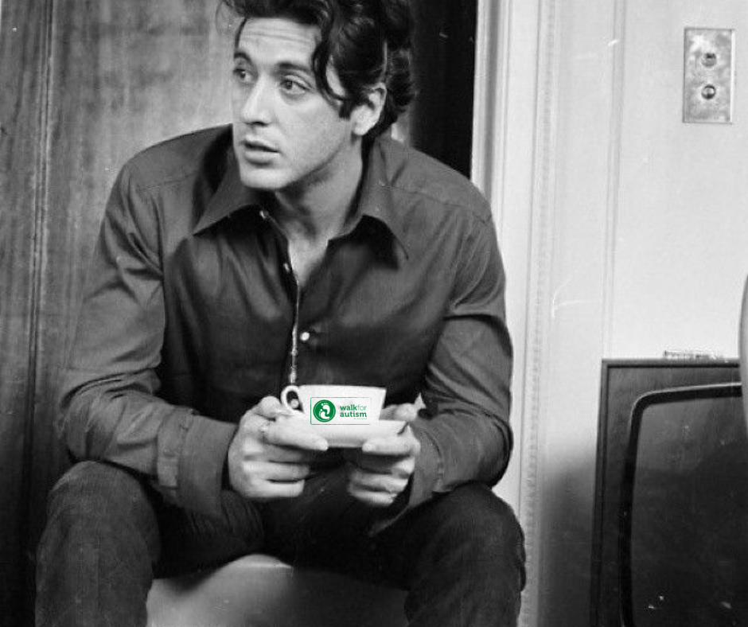
1

Slide 3
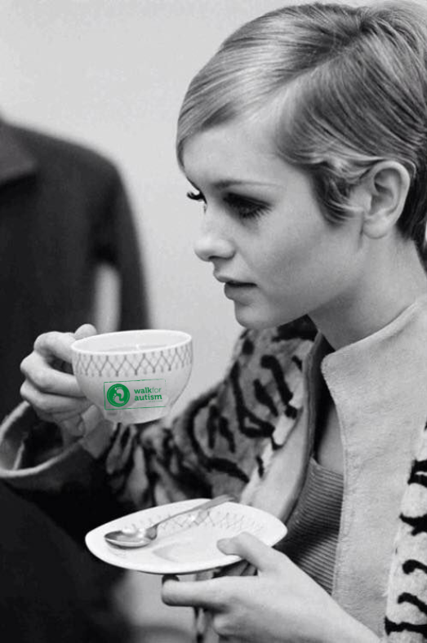
2

Slide 4
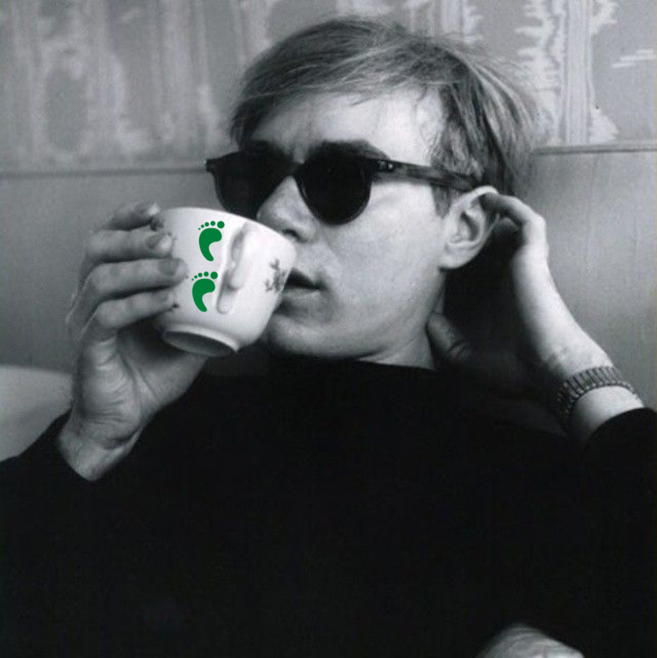
3

Slide 5
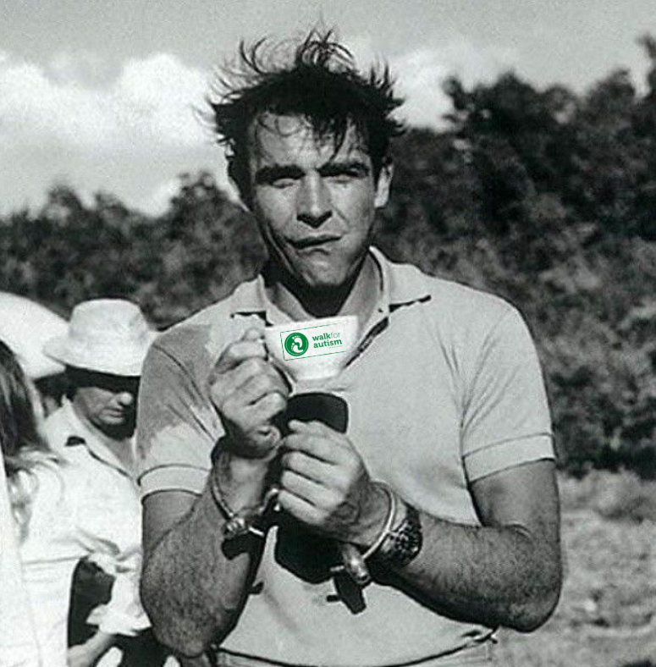
4

Slide 6
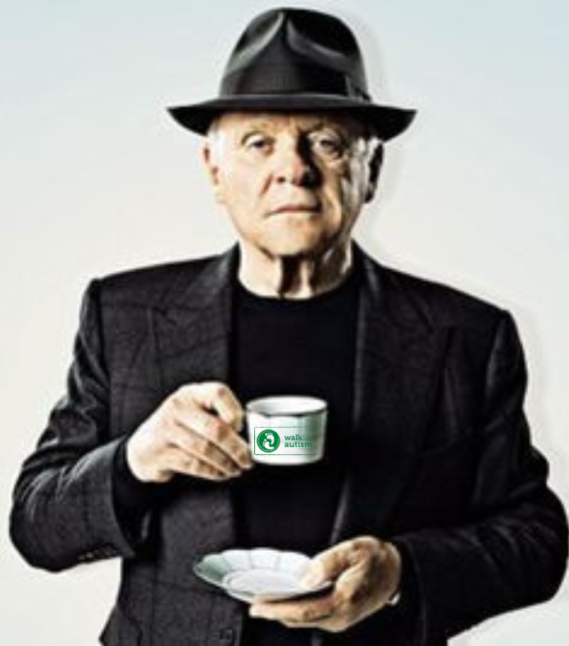
5

Slide 7
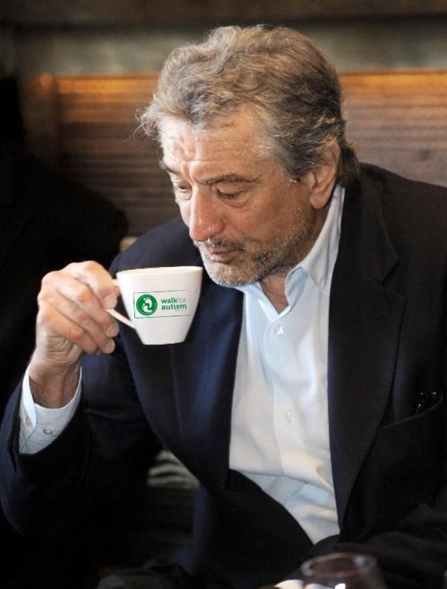
6

Slide 8
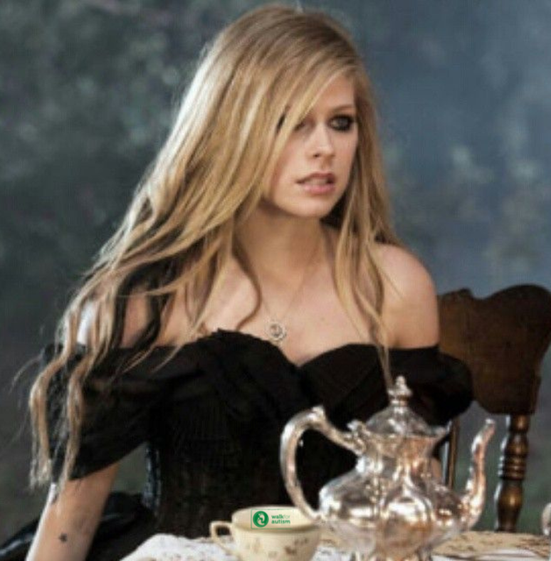
7

Slide 9
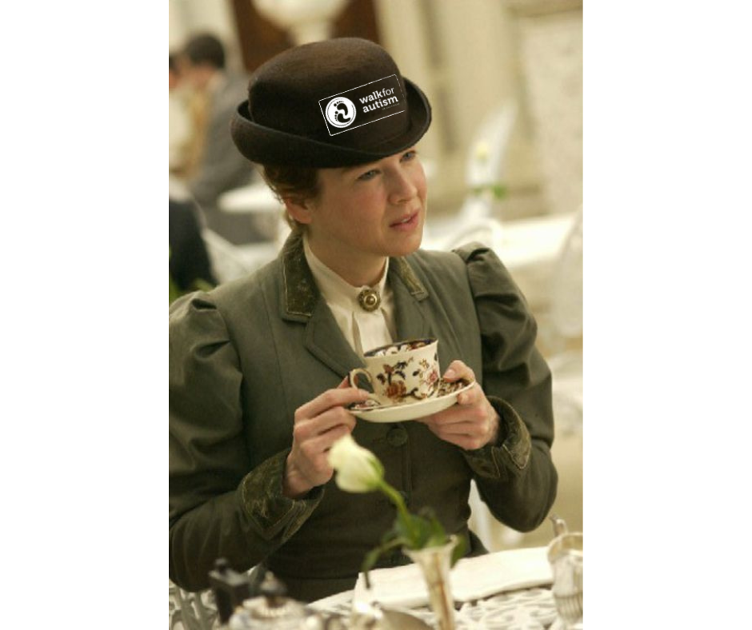
8

Slide 10
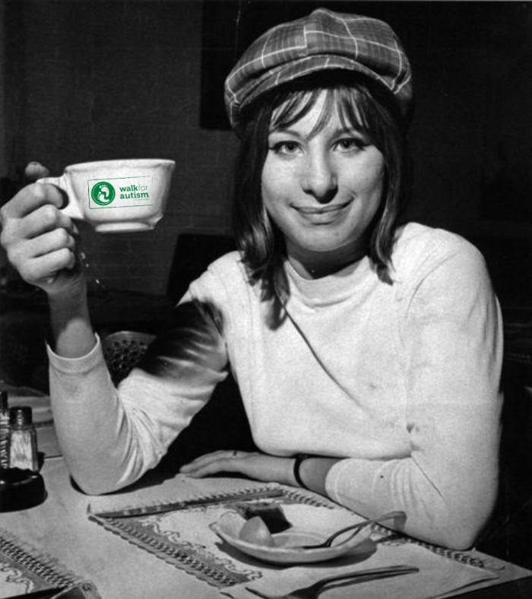
9

Slide 11
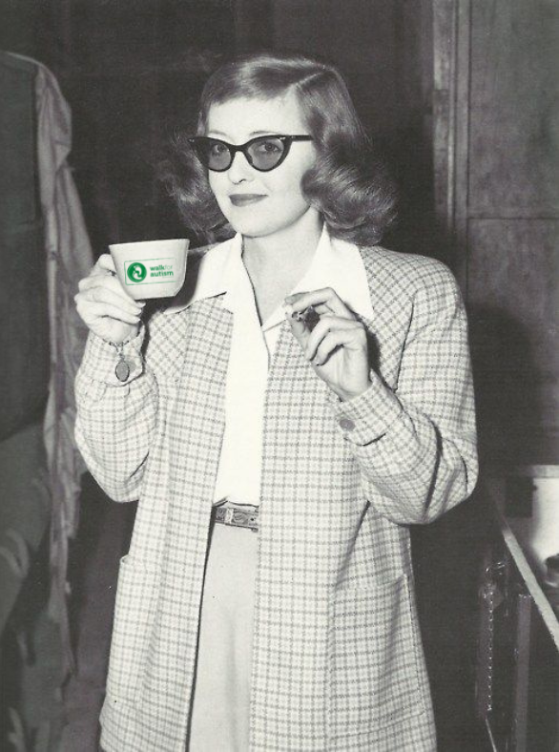
10

Slide 12
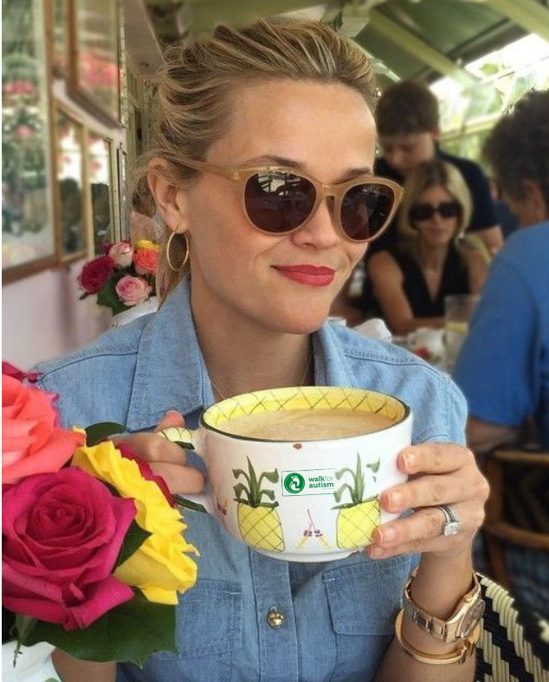
11

Slide 13
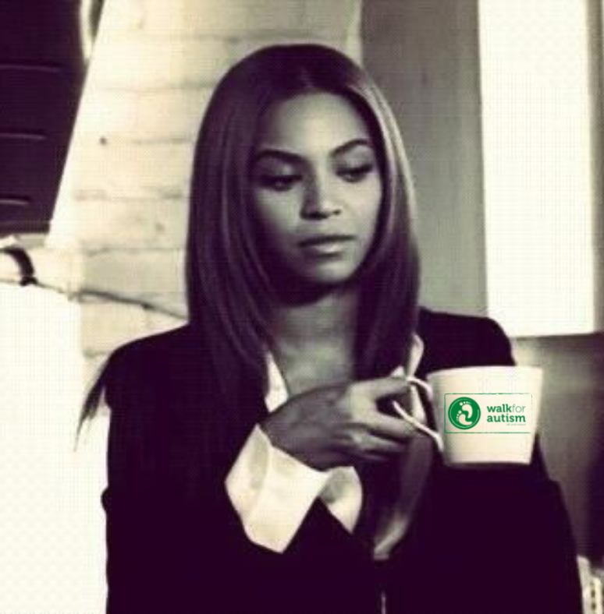
12

Slide 14
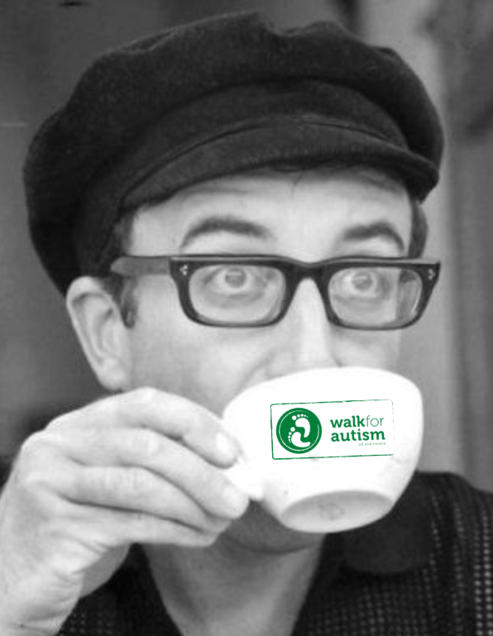
13

Slide 15
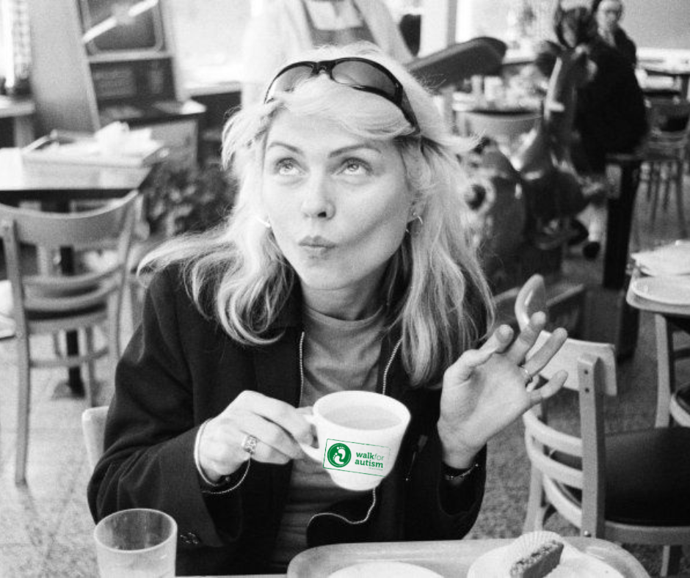
14

Slide 16
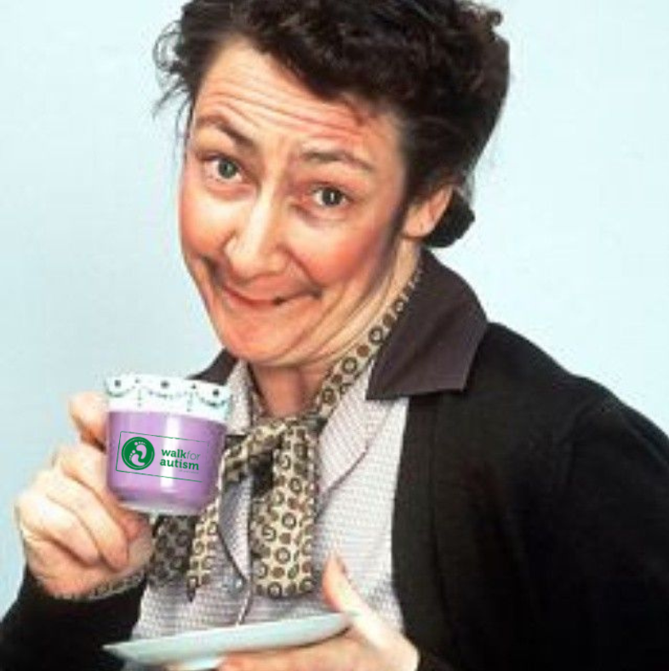
15

Slide 17
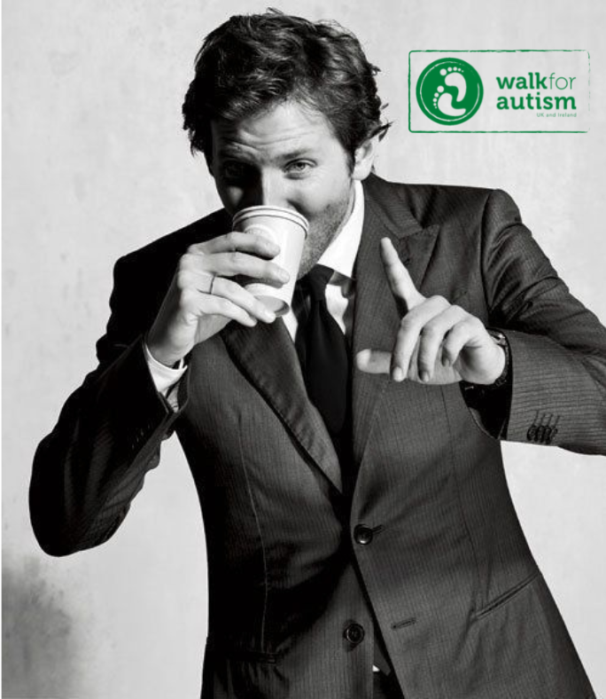
16

Slide 18
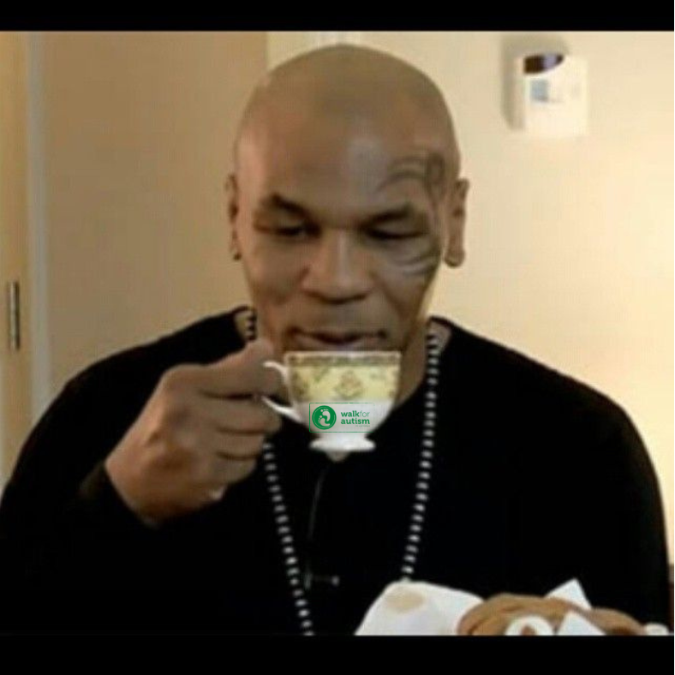
17

Slide 19
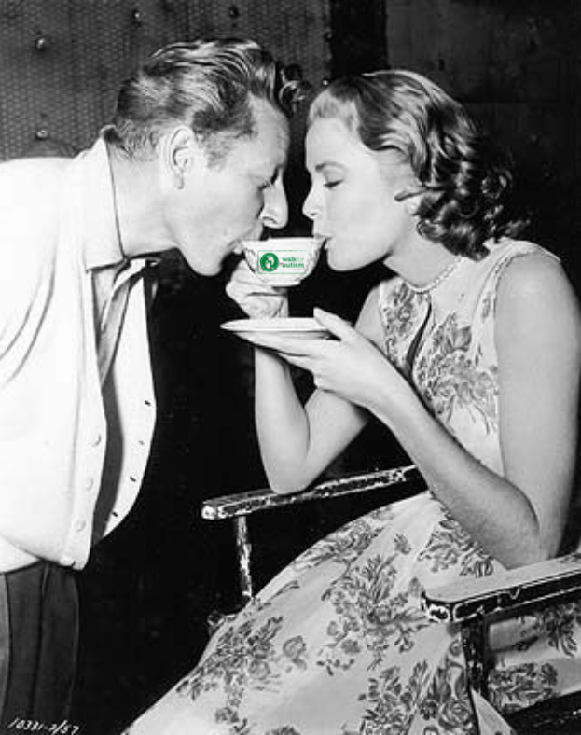
18 & 19

Slide 20
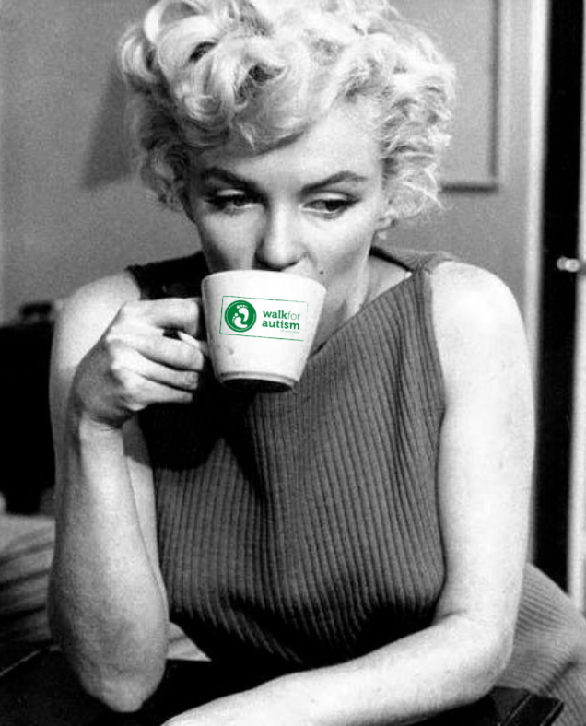
20

Slide 21
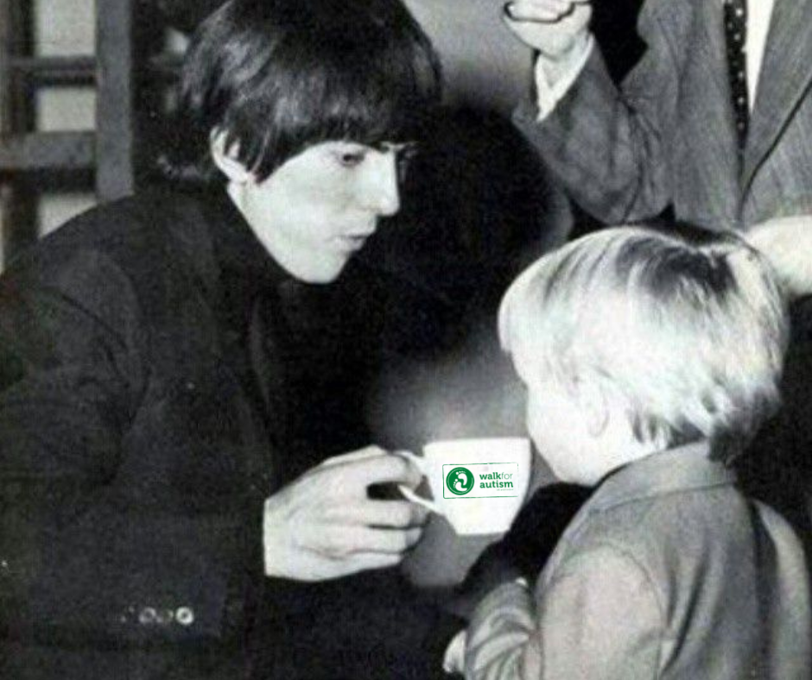
21

Slide 22
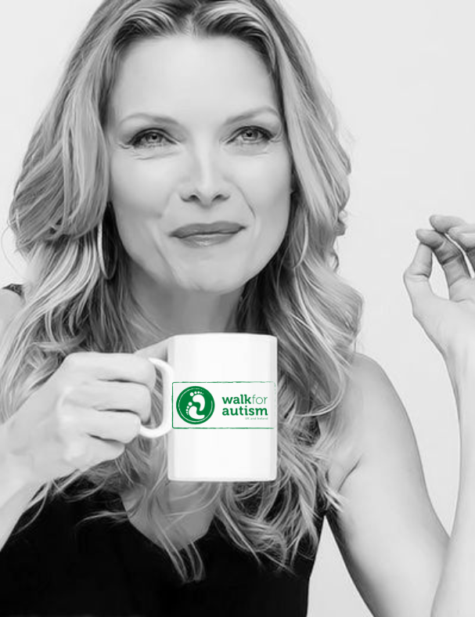
22

Slide 23
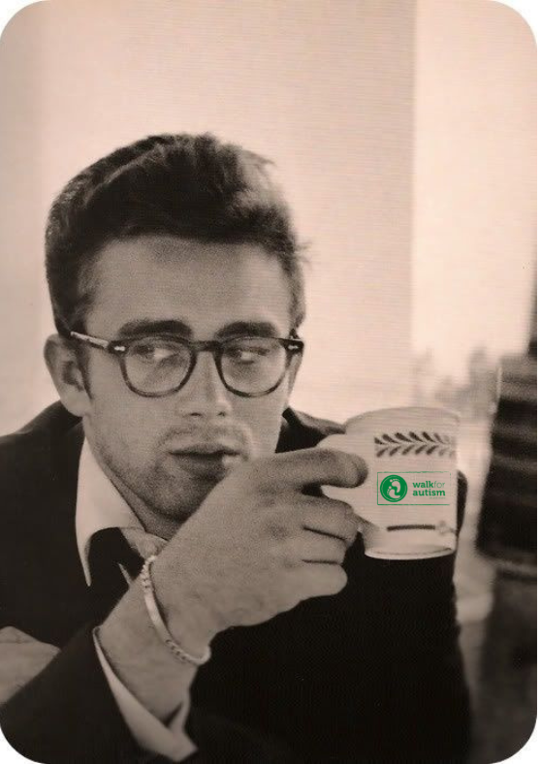
23

Slide 24
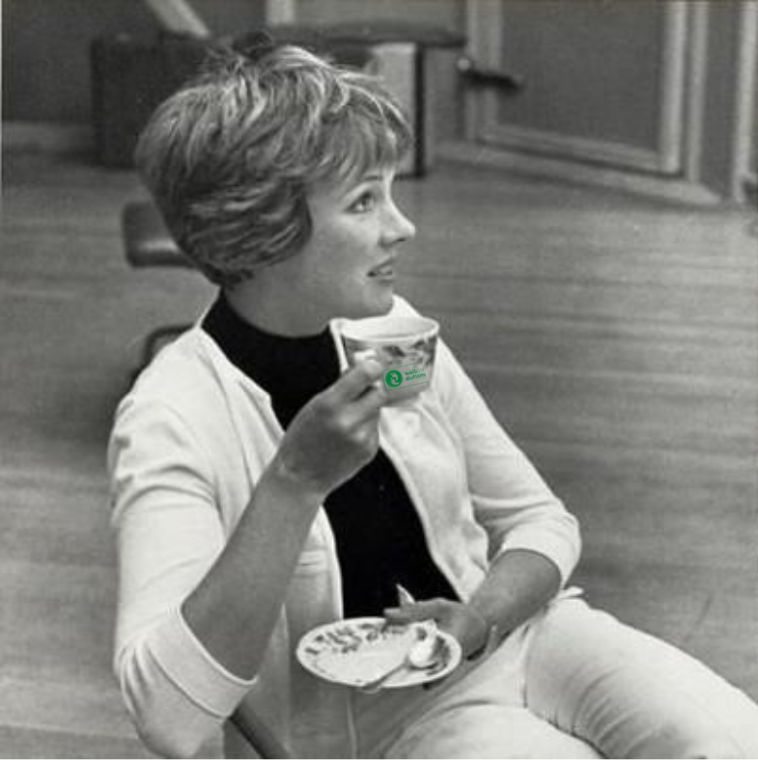
24

Slide 25
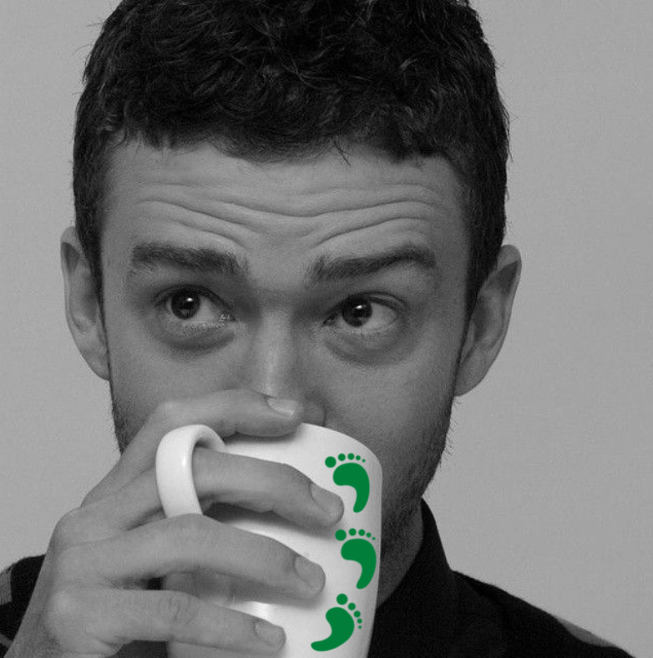
25

Slide 26



Slide 27
1
Al Pacino

Slide 28
2
Twiggy

Slide 29
3
Andy
Warhol

Slide 30
4
Sean
Connery

Slide 31
5
Anthony
Hopkins

Slide 32
6
Robert
De Niro

Slide 33
7
Avril
Lavene

Slide 34
8
Renee
Zelwega

Slide 35
9
Barbara
Streisand

Slide 36
10
Bette
Davis

Slide 37
11
Reese
Witherspoon

Slide 38
12
Beyonce

Slide 39
13
Peter
Sellers

Slide 40
14
Blondie

Slide 41
15
Pauline McLynn
(Mrs Doyle)

Slide 42
16
Bradley
Cooper

Slide 43
17
Mike
Tyson

Slide 44
18 & 19
Danny Kaye
&
Grace Kelly

Slide 45
20
Marilyn
Monroe

Slide 46
21
George
Harrison

Slide 47
22
Michelle
Pfeiffer

Slide 48
23
James
Dean

Slide 49
24
Julie
Andrews

Slide 50
25
Justin
Timberlake

Slide 51


THE
END

